Slide 1

Dr. N.G.P Arts and Science College (An autonomous institution, affiliated to Bharathiyar University, Coimbatore) Accredited with NAAC with A++ Grade (3rd cycle-3.64 CGPA) Dr. N.G.P Kalapatti road, Coimbatore- 641 048, Tamil Nadu.
DEPARTMENT OF ARTIFICIAL INTELLIGENCE AND MACHINE LEARNING
REAL TIME PERSON INDENTIFTY DETECTION
Under The Guidance of
Mrs. T. Hashni, M.Sc., M.Phil., (Ph.D.),
By,
KOWSIKA B
221AI025
III B. Sc. Artificial Intelligence and Machine Learning

Slide 2

.
ABSTRACT
Real-time person identification detection is an advanced technology that leverages computer vision, machine learning, and biometric systems to instantly recognize individuals in live video streams or images.
The process involves detecting human presence, extracting unique features (e.g., facial landmarks, gait, or biometric data), and matching them against a pre-existing database for identification.
This technology is widely used in security, surveillance, access control, and personalized services, enabling immediate decision-making such as granting access or triggering alerts.
Real-time person identification is becoming faster, more accurate, and scalable, offering significant potential for enhancing security and convenience while requiring careful consideration of ethical and privacy implications.
Dr. NGPASC
COIMBATORE|INDIA

Slide 3
.
INTRODUCTION
Real-time person identification detection is a transformative technology that combines computer vision, machine learning, and biometric systems to instantly recognize individuals in live video streams or images.
By detecting human presence, extracting unique features (e.g., facial landmarks, gait, or biometric data), and matching them against a database, this system enables immediate identification and decision-making.
It is widely used in security, surveillance, access control, and personalized services, offering applications such as identifying suspects, granting restricted access, or enhancing customer experiences.
With the rise of AI advancements, real-time person identification is becoming more efficient and scalable, promising significant improvements in security and convenience while necessitating careful ethical considerations.
Dr. NGPASC
COIMBATORE|INDIA

Slide 4
EXISTING SYSTEMS
Convolutional Neural Networks (CNNs) are widely used in real-time person identification systems due to their ability to extract complex features from images.
SSD (Single Shot Detector) use CNN-based architectures for real-time object and person detection, ensuring fast and efficient processing.
These systems are integrated into surveillance cameras, access control systems, and mobile devices for applications such as security, attendance tracking, and personalized services.
CNNs excel in handling variations in lighting, pose, and occlusions, making them robust for real-world scenarios.
With advancements in GPU acceleration CNN-based systems are becoming more efficient, enabling real-time performance even on resource-constrained devices.
Dr. NGPASC
COIMBATORE|INDIA

Slide 5
PROPOSED SYSTEM
The proposed system integrates YOLO (You Only Look Once) for real-time person detection and a deep fake detection algorithm to enhance security and accuracy.
YOLO ensures fast and efficient detection of individuals in live video streams by leveraging its CNN-based architecture.
Once a person is detected, the system employs a deep fake detection algorithm to verify the authenticity of the detected face, preventing spoofing or impersonation using synthetic media.
This dual approach improves reliability in applications like access control, surveillance, and identity verification.
The deep fake detection algorithm analyzes subtle artifacts in facial features, such as inconsistencies in lighting or texture, to distinguish real faces from fake ones.
Dr. NGPASC
COIMBATORE|INDIA

Slide 6
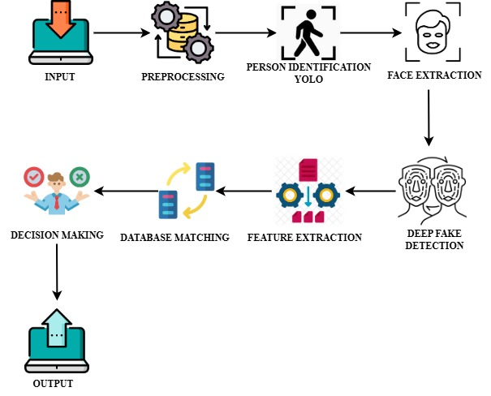
ARCHITECTURE DIAGRAM
Dr. NGPASC
COIMBATORE|INDIA

Slide 7
SYSTEM REQUIREMENTS
HARDWARE REQUIREMENT
PROCESSOR - INTEL ® CORE ™ I9-14900K 3.20 GHZ
RAM - 16 GB
HARD DISK - 1 TB
Dr. NGPASC
COIMBATORE|INDIA

Slide 8
.
SOFTWARE REQUIREMENTs
Frontend :HTML,CSS
Backend : PYTHON
Framework : FLASK

Slide 9
MODULES
Input Module
Preprocessing Module
Person Detection Module (YOLO)
Face Extraction Module
Deep Fake Detection Module
Feature Extraction Module
Database Matching Module
Decision Module
Output Module
Dr. NGPASC
COIMBATORE|INDIA

Slide 10
.
1. Input Module: This module captures live video streams or images using cameras or CCTV systems. It serves as the entry point for data, providing raw video frames for further processing.
2. Preprocessing Module: Raw video frames are prepared for analysis in this module. It extracts individual frames from the video and performs resizing and normalization to ensure consistency and improve processing efficiency.
3. Person Detection Module (YOLO): Using the YOLO (You Only Look Once) algorithm, this module detects and localizes persons in the video frames. YOLO’s CNN-based architecture ensures fast and accurate detection, outputting bounding box coordinates for each detected person.
Dr. NGPASC
COIMBATORE|INDIA

Slide 11
.
4. Face Extraction Module: Once persons are detected, this module isolates their faces by cropping the regions defined by the bounding boxes. It also aligns the faces to ensure uniformity for further analysis.
5. Deep Fake Detection Module: To enhance security, this module verifies the authenticity of detected faces. It uses a deep fake detection algorithm to identify synthetic or manipulated faces by analyzing inconsistencies in lighting, texture, or artifacts.
6. Feature Extraction Module: This module extracts unique facial features, such as landmarks (eyes, nose, mouth), and converts them into numerical embeddings using models like FaceNet. These embeddings represent the facial features in a high-dimensional space.
Dr. NGPASC
COIMBATORE|INDIA

Slide 12
.
7. Database Matching Module: The extracted embeddings are compared against a pre-registered database of known individuals. Matching algorithms compute similarity scores to identify the person or flag them as "Unknown."
8. Decision Module: Based on the identification results, this module takes appropriate actions, such as granting access, denying entry, or triggering alerts for unauthorized or fake identities.
9. Output Module: The final module displays the results, showing identified persons with bounding boxes and labels. It also sends alerts or logs the results for future reference.
Dr. NGPASC
COIMBATORE|INDIA

Slide 13
CONCLUSION
Real-time person identification detection, powered by technologies like YOLO and deep fake detection algorithms, represents a significant advancement in security and surveillance systems.
By combining fast and accurate person detection with robust authenticity verification, the system ensures reliable identification even in challenging conditions.
The integration of YOLO based models for feature extraction and matching enhances accuracy, while deep fake detection adds an essential layer of security against spoofing and synthetic media threats.
This technology has wide-ranging applications, from access control and surveillance to personalized services, offering both convenience and enhanced security.
As the field evolves, real-time person identification systems will continue to play a pivotal role in creating safer and smarter environments.
Dr. NGPASC
COIMBATORE|INDIA

Slide 14
REFERENCE
D.-H. Im, Y.-S. Seo, H. Kim, E. Hwang, and J. Park, “Person reidentification in movies/dramas,” in 2020 International Conference on Information and Communication Technology Convergence (ICTC). IEEE, 2020, pp. 1596–1598.
O. Hamdoun, F. Moutarde, B. Stanciulescu, and B. Steux, “Person reidentification in multi-camera system by signature based on interest point descriptors collected on short video sequences,” in 2008 Second ACM/IEEE International Conference on Distributed Smart Cameras. IEEE, 2008, pp. 1–6.
Y. Zhang, Z. Guo, J. Wu, Y. Tian, H. Tang, and X. Guo, “Real-time vehicle detection based on improved yolo v5,” Sustainability, vol. 14, no. 19, p. 12274, 2022.
M. Rezaei and M. Azarmi, “Deepsocial: Social distancing monitoring and infection risk assessment in covid-19 pandemic,” Applied Sciences, vol. 10, no. 21, p. 7514, 2020.
Dr. NGPASC
COIMBATORE|INDIA

